Slide 1
DR. TONGUE
Harsh Shroff
Meet Velani
Daivik Rajgor
Neha Uttwani

Slide 2
Problem Statement
Tongue characteristics, such as tongue shape and color, can reflect the internal health status of the body (e.g., organs, qi, blood, cold, heat) and the severity or progression of the diseases. By observing tongue characteristics, TCM practitioners can differentiate clinical symptoms and choose proper treatments.
However, traditional tongue diagnosis is based on practitioners’ subjective eye observation, which is often biased by personal experience, environmental lighting variations, and etc. Therefore, it is necessary to develop an objective and quantitative tongue diagnostic method that can aid practitioners’ diagnosis.

Slide 3
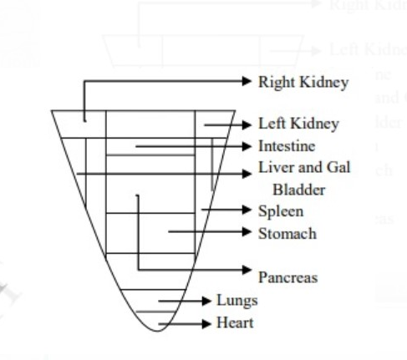
Proposed Solution
The tongue tip reflects the pathological changes in the heart and lungs, while the bilateral sides of the tongue reflect that of the liver and gallbladders.
The pathological changes in the spleen and stomach are mirrored by the center of tongue, while changes in the kidneys, intestines, and bladder section correspond to the tongue root.

Slide 4
In Traditional Chinese Medical (TCM) science, tongue images can be observed for medical diagnosis; however, the tongue diagnosis of TCM is influenced by the subjective factors of doctors, and the diagnosis results vary from person to person.
Quantitative TCM tongue diagnosis can improve the accuracy of diagnosis and increase the application value.
In this project, digital image processing and pattern recognition technologies are employed in mobile application to classify tongue images collected in different health states.
This computerized tongue diagnosis can aid medical practitioners in capturing quantitative features to improve reliability and consistency of diagnosis.

Slide 5
Technology Used
The illustration of tongue image capturing with standard equipment.
Construction of the raw tongue image dataset and exemplar of tooth-marked and non-tooth-marked tongue.
Construction of the tongue region image dataset and exemplar of tooth-marked and non-tooth-marked tongue.
The training, testing, and validating of the convolutional neural network model.
The testing of the models in a new dataset of tongue images captured by ordinary camera.

Slide 6
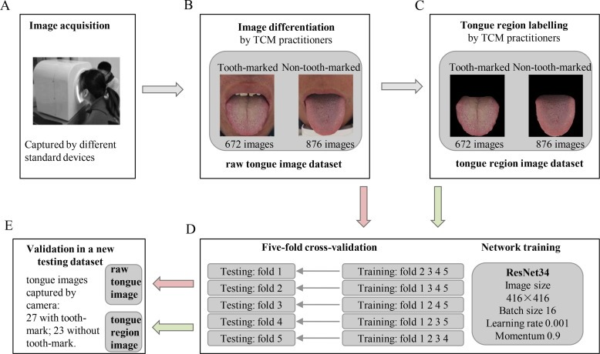
Detailed Block Diagram

Slide 7
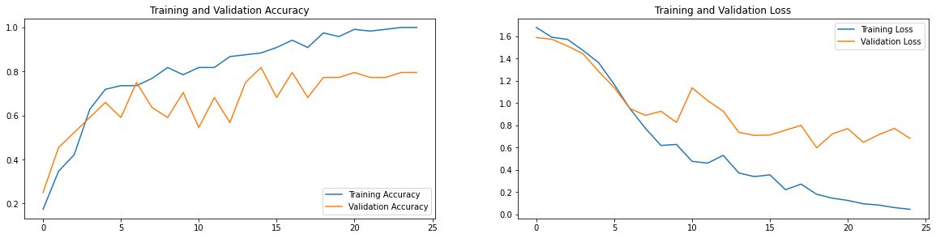
Model Performance

Slide 8
Target Market
Common Man
Doctors in ENT Field(otolaryngologist)

Slide 9
THANK YOU!

